Slide 1


Python Data Science For Fun And Profit
Presented By
Eng. Ahmed Genedy
Gene IT Solutions
www.gene-eg.com

Slide 2



About Gene IT Solutions
AKA BigProf Software, bigprof.com
Established since 2003.
Developers of AppGini, one of the fastest and easiest tools for small businesses to create powerful web-based multi-user business applications, without writing any code.
Over 100,000 users world-wide.
We believe in open source, and in users having full control of their business tools.
We recently launched a plugins market place to expand our tool set .. And you’re welcome to join!

Slide 3

What is data science?
Data Science is the study of data. It is about extracting, analyzing, visualizing, managing and storing data to create insights. These insights help governments, organizations, companies, researchers, .. etc. to make powerful data-driven decisions. Data Science involves the usage of both unstructured and structured data.

Slide 4

A crash course in Python

Slide 5
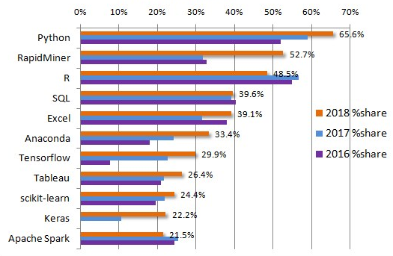
Why Python for data science?
Growing popularity.
Powerful data science libraries and tools.
Very easy to learn and use.
Great community.

Slide 6
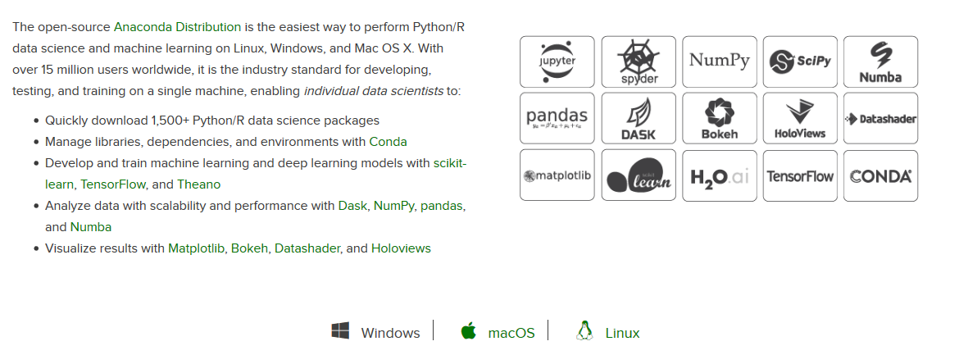
Tools needed: Anaconda, anaconda.com

Slide 7
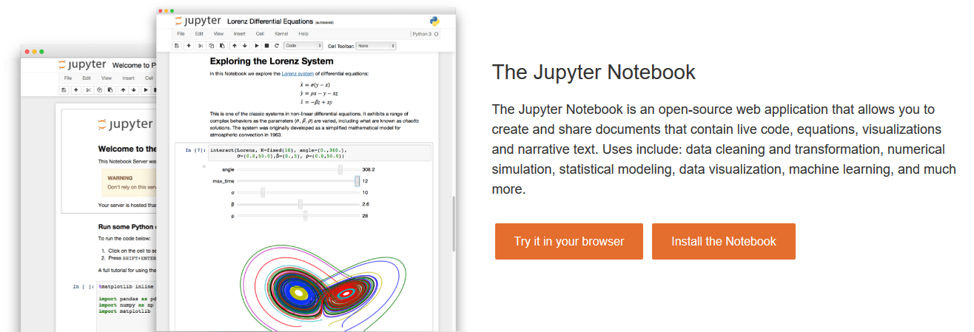

Slide 8
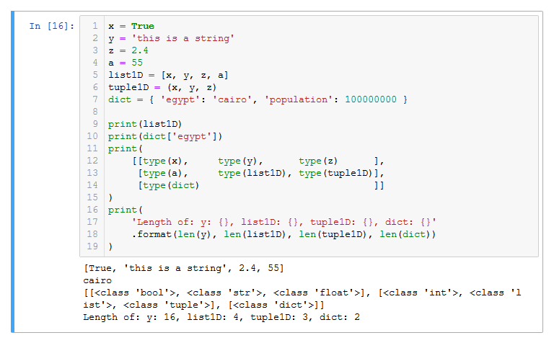
Core data types of Python

Slide 9
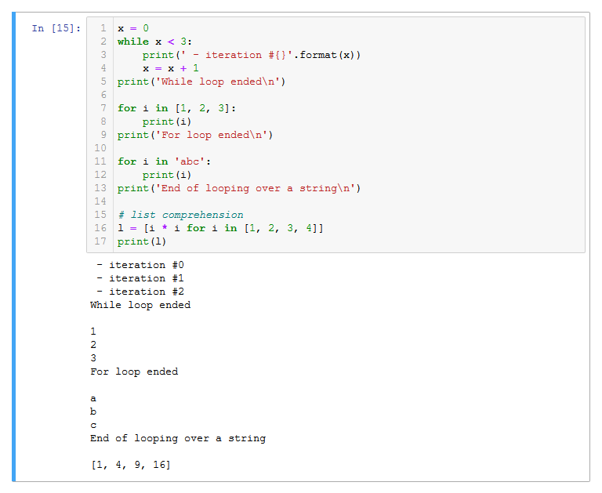
Loops

Slide 10
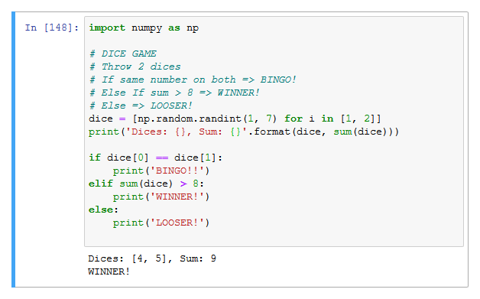
If/else checks

Slide 11
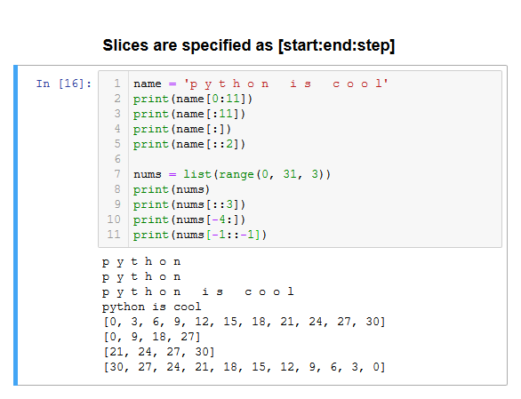
Slicing

Slide 12
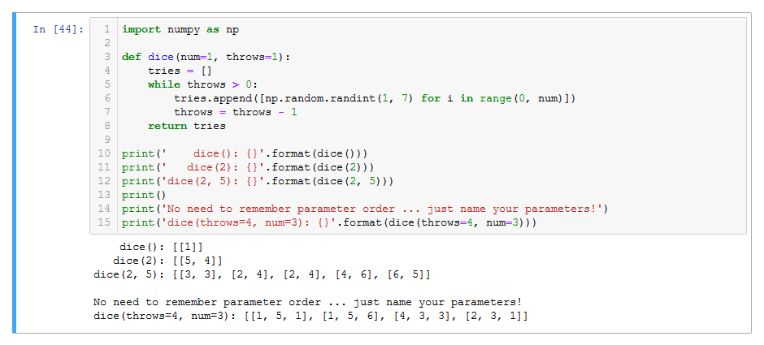
Defining functions

Slide 13
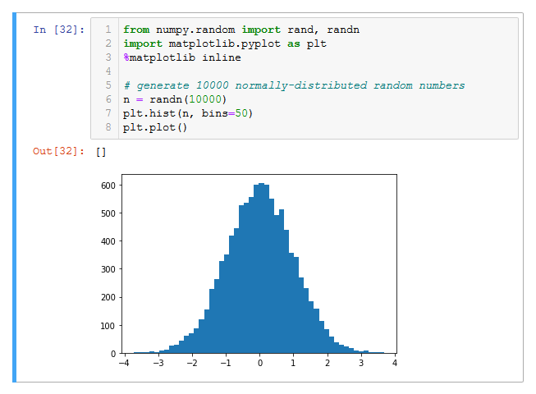
Hello matplotlib!

Slide 14

Lab assignment
Create a histogram containing 2 data series:
1 million normally distributed random values.
1 million uniformly distributed random values, with range from -4 to 4.
Add a legend to the histogram indicating which color represents normal distribution and which for uniform distribution.

Slide 15
Homework assignment
Given the following quarterly sales data:
Plot a barchart with quarters on the horizontal axis, and sales on the vertical axis, showing each year as a separate bar, with a legend indicating years, as shown in the above chart.
Plot a stacked barchart with years on the horizontal axis, and sales on the vertical axis. Each year’s bar should be a stack of Q1, Q2, Q3 and Q4 sales, with a legend indicating quarters.
TIP: refer to matplotlib gallery for help! https://matplotlib.org/gallery.html
 | Q1 | Q2 | Q3 | Q4
2017 | 425 | 366 | 498 | 403
2018 | 486 | 385 | 546 | 432
2019 | 474 | 390 | 538 | 412

Slide 16
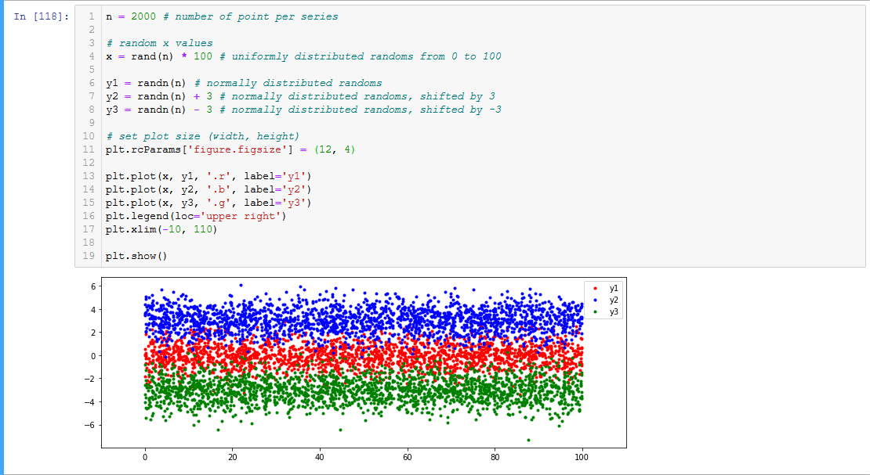
Another matplotlib example

Slide 17
Numpy arrays vs lists
Arithmetic operations
Array, scalar
Array, array
Slicing 2D arrays (get specific row(s)/column(s))

Slide 18

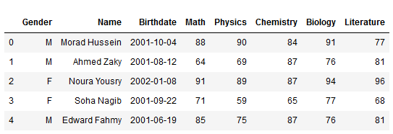
Pandas and data frames
Columns
Index
Data

Slide 19
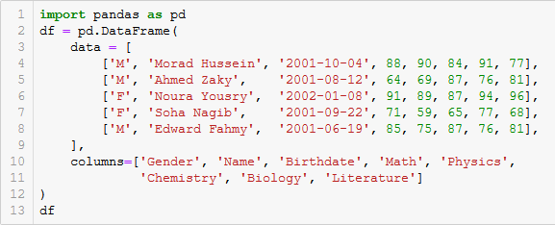
Manually defining a data frame

Slide 20
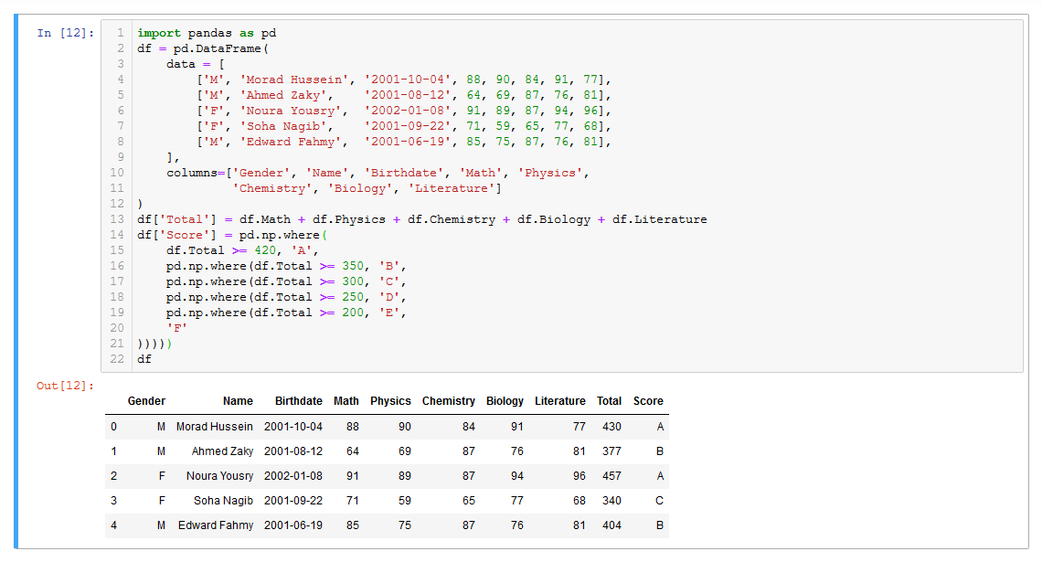
Data frame calculations

Slide 21
More data frame operations (1/5)
Renaming columns: df.rename({}, axis='columns’)
Slicing: df.loc[start_index:end_index:step, start_col:end_col:index] .reset_index(drop=True)
Converting data types: df.astype({col: dtype, ..})
In case of some empty cells: df.col = pd.to_numeric(df.col).fillna(0)
Apply: df.apply(function, param1, param2, …)

Slide 22
More data frame operations (2/5)
Concatenate rows/columns from multiple data frames:
pd.concat([df1, df2, …], ignore_index=True)
pd.concat([df1, df2, …], axis='columns’)
Filtering:
df[df.col > 20]
df[df.col.isin([val1, val2, …])] # use ~ for negation
df[(cond1) & (cond2)] # or: | … brackets must be used

Slide 23
More data frame operations (3/5)
Aggregate methods:
df.col.sum() # try mean,count,value_counts, …
df.col.agg('sum', 'count’)
df['new_col'] = df.col.transform('sum')
Show only records of top categories: df[df.col.isin(df.col.value_counts().nlargest(10).index)]
Grouping:
df.groupby('col') # then use an agg. function on some column
df.groupby([])
unstack() # convert grouped data set to a data frame

Slide 24
More data frame operations (4/5)
Split a column into some new columns: df[['fname', 'lname']] = df.fullname.str.split(' ', expand=True)
Sorting:
df.sort_values(col) # or [col1, col2 ..]
df.sort_values(col, ascending=False) # or ascending=[True, False ..]
axis='columns' # to sort columns
inplace=True # same df rather than a copy
na_position='first’ # NaNs are last by default
Quiz: agg vs transform vs apply?

Slide 25
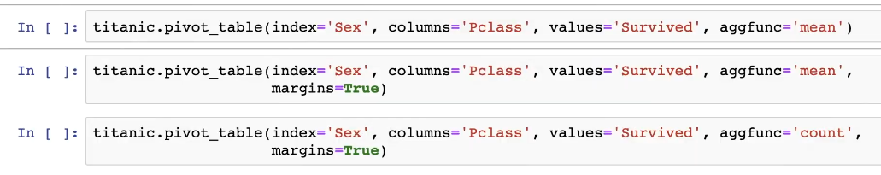
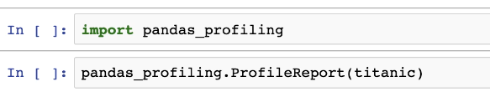
More data frame operations (5/5)
Pivot tables
Profiling data frames

Slide 26

Let’s play with some real-world data!
Uber raw pickup data for NYC, April 2014, https://www.kaggle.com/fivethirtyeight/uber-pickups-in-new-york-city
(find the file ‘uber-raw-data-apr14.csv’)

Slide 27
Exploring the data set
Load
Load data: data = pd.read_csv(‘path/to/file’)
Preview
Take a look on how the data looks like: data.head() data.tail()
Inspect
See how are column data types recognized (and memory usage): data.info() data.describe()
Clean up
Clean up data. For example, to convert date/time string to a datetime object, adjust loading to: data = pd.read_csv(‘path/to/file’, parse_dates=[0])
Tips
You’ll know dates are parsed if you see them in the format: Y-m-d or Y-m-d H:i:s
Useful read_csv params: use_cols=[], dtypes={}
Use category data type for repeated strings to reduce memory usage

Slide 28
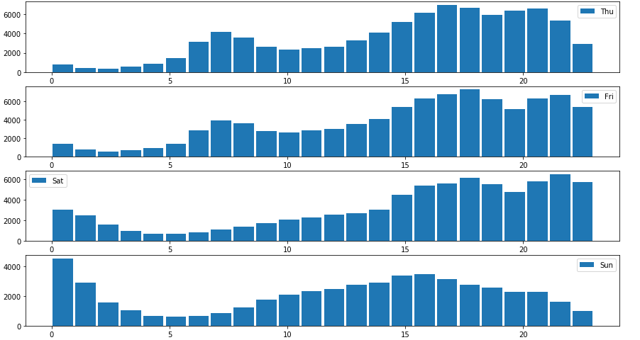
Visualize data and find insights

Slide 29
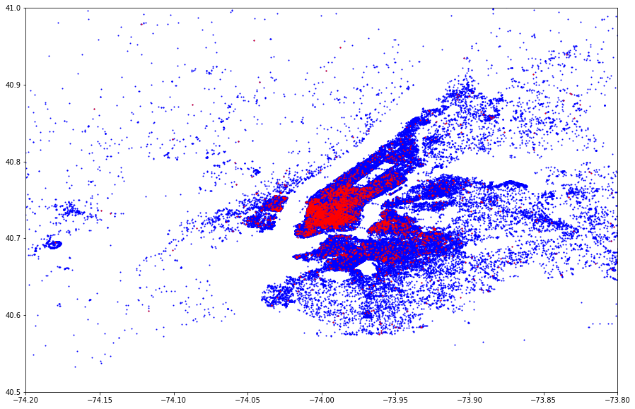
Visualize data and find insights

Slide 30
Thank you, and I hope you’ve enjoyed this intro!
Where do we go from here?
Seaborn: More powerful charts.
Explore and play with free data sets from Kaggle.com
Machine learning

